Slide 1
SQL
Week 7, Summer 2024. 7/30 (Tues)
Lecture 23

Slide 2
Announcements
"Official" course evaluation survey released
https://course-evaluations.berkeley.edu/Berkeley/
Filling this out will be a huge help for the Data/DSUS department with regard to course development, so please fill this out :)
Project02 ("Ants") due this Thursday (8/1)!

Slide 3
Announcements: Final Exam
Final exam "primary" time: Wednesday August 7th, 3PM – 5 PM PST
Final exam scheduling form released
Gradescope: "(Urgent) Final Exam Scheduling"
Due: Wednesday July 31st 11:59 PM PST
Please fill this out ASAP! For more info, see Ed post.
DSP students: you should have received an email for a separate Final exam scheduling form. Please fill this out – if you didn't receive an e-mail, let us know!
Final exam will have the same style as the Midterm
Zoom+Gradescope

Slide 4
Filtering in SQL

Slide 5
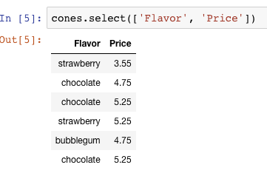
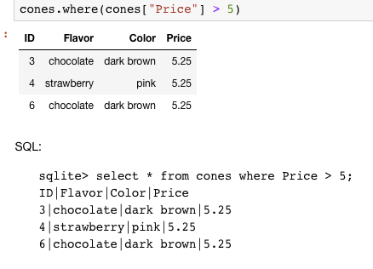
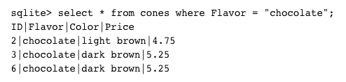
Filtering rows - where
Set of Table records (rows) that satisfy a condition
select [columns] from [table] where [condition] order by [order] ;

Slide 6
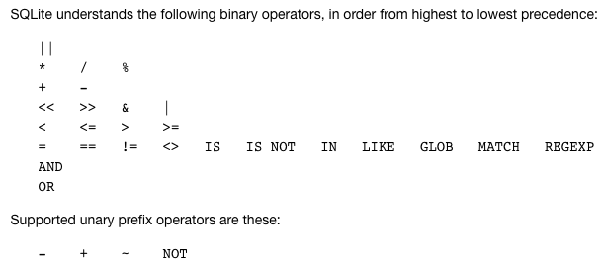
SQL Operators for predicate
use the WHERE clause in the SQL statements such as SELECT, UPDATE and DELETE to filter rows that do not meet a specified condition

Slide 7
Approximate Matching: LIKE [Docs]
LIKE compares text to a pattern
Case-Insensitive by default. Means 'a' and 'A' are the same.
Allows "wildcards" that match any character.
% means "zero or more" characters at this "spot" in the pattern
Examples:
'abc' LIKE 'abc' → true
'abc' LIKE 'a%' → true
'abc' LIKE '%b%' → true –shortcut for "does abc contain b?"
'b' LIKE '%b%' → true
'abc' LIKE 'c' → false

Slide 8
Summary
SQL a declarative programming language on relational tables
largely familiar to you from data8
create, select, where, order, group by, join
Databases are accessed through Applications
e.g., all modern web apps have Database backend
Queries are issued through API
Be careful about app corrupting the database
Data analytics tend to draw database into memory and operate on it as a data structure
e.g., Tables

Slide 9
Summary – Part 1
SELECT <col spec> FROM <table spec> WHERE <cond spec>
GROUP BY <group spec> ORDER BY <order spec> ;
INSERT INTO table(column1, column2,...)
VALUES (value1, value2,...);
CREATE TABLE name ( <columns> ) ;
CREATE TABLE name AS <select statement> ;
DROP TABLE name ;

Slide 10
SQL: Aggregations

Slide 11
Aggregations are Powerful & Common!
SELECT date, COUNT(*)
FROM users
WHERE date > "2024-06-01"
GROUP BY date;
This query means: From the `users` table, fetch all rows whose `date` column is > `current_date`, group them by `date`, and count how large each group is.
Note: query results are also a table!
user_name | date
"bob" | 2024-06-01
"alice" | 2024-06-01
"louis" | 2024-06-02
"alyssa" | 2024-06-03
… | …
date | count
2024-06-02 | 136
2024-06-03 | 257
2024-06-04 | 326
2024-06-05 | 167
… | …
There are 257 rows with date=2024-06-03
`users` table
Query results

Slide 12
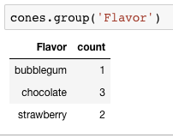
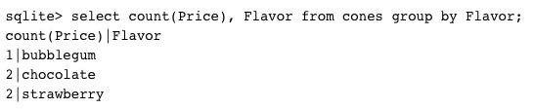
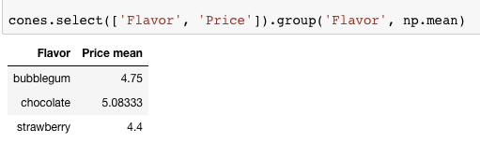
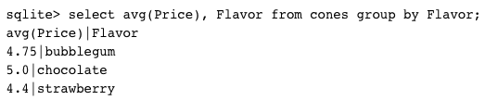
Grouping and Aggregations
The GROUP BY clause is used to group rows returned by SELECT statement into a set of summary rows or groups based on values of columns or expressions.
Apply an aggregate function, such as SUM, AVG, MIN, MAX or COUNT, to each group to output the summary information.

Slide 13
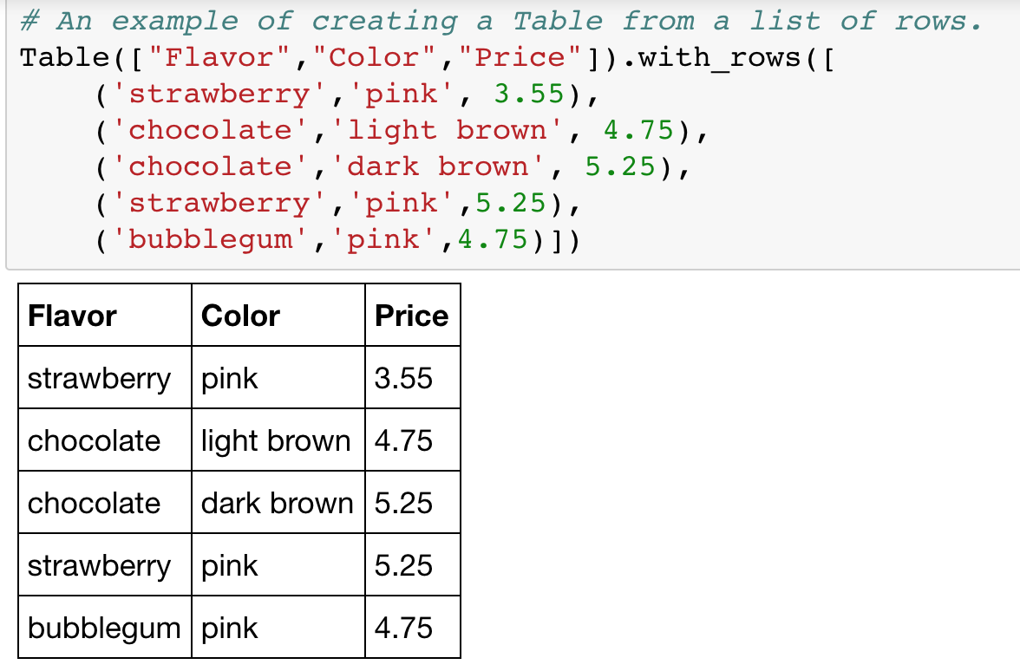
Grouping and Aggregations
aggregator function (average)
Group keys (can be more than one!)
# Flavor, Price
strawberry, 3.55
strawberry, 5.25
# Flavor, Price
chocolate, 4.75
chocolate, 5.25
chocolate, 5.25
# Flavor, Price
bubblegum, 4.75
GROUP by Flavor
# Flavor, Price
strawberry, (3.55 + 5.25) / 2
# Flavor, Price
chocolate, (4.75 + 5.25 + 5.25) / 3
# Flavor, Price
bubblegum, (4.75) / 1
avg(Price)
# Flavor, avg(Price)
strawberry, 4.4
chocolate, 5.0833
bubblegum, 4.75
avg(Price) is the result of computing the average Price within each group

Slide 14
Group by: "Bare" columns
Caution: when using "GROUP BY", all selected columns MUST be one of:
(1) included in "GROUP BY"
Or
(2) in an aggregation function
sqlite> select flavor, avg(price), color from cones group by flavor;
# flavor, avg(price), color
bubblegum|4.75|pink
chocolate|5.083333333333333|light brown
strawberry|4.4|pink
It's confusing to have a query where it's not clear what the output will be.
Hence the recommendation to put selected columns in either "GROUP BY" clause OR in an aggregation function.
SQL arbitrarily chose one of the "chocolate" group Color values: "light brown" or "dark brown". Weird!
Note: in many other SQL engines, it's an error to have a "bare" column.
For more info on sqlite3's "bare columns", read this interesting (and colorful) thread: https://sqlite.org/forum/forumpost/4c8a673560d7999a

Slide 15
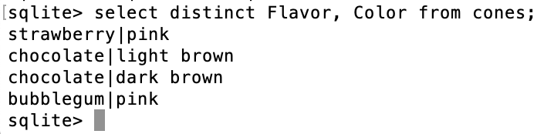
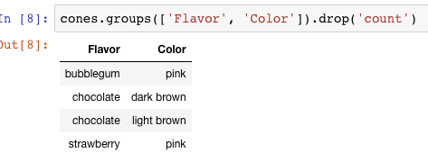
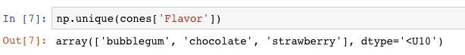
Unique & DISTINCT values
select DISTINCT [columns] from [table] where [condition] order by [order] ;

Slide 16
SQL: Joins

Slide 17
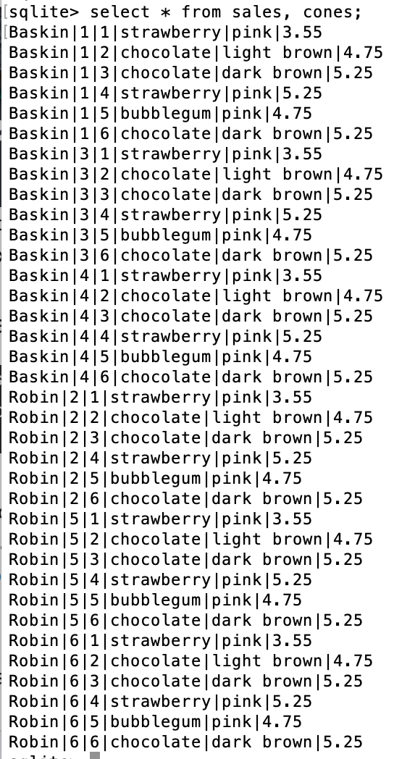
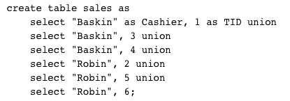
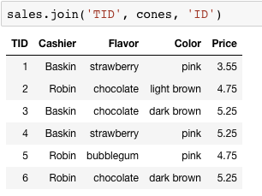
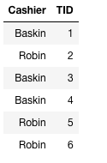
Joining tables
Two tables are joined by a comma to yield all combinations of a row from each (aka "Cartesian Product")
select * from sales, cones;

Slide 18
Joins
Joins combine two tables
A "cross product" or full join gives all combinations
This is often not useful!
So, we can do an inner join where we "combine" rows only on some logical identifier, like an "id"
Often this is called a "foreign key" or a reference to an object in another table.

Slide 19
Inner Join
Suppose that the `sales, cones` tables are set up such that sales.cone_id corresponds to the cones.id.
Ex: sales row `Baskin,1,2` means that Cashier=Baskin sold a cone with cone_id=2, aka `1,chocolate,light brown,4.75`
Then, to determine the Flavor, Color and Price of all sales made, we do this join:
# Cashier, id, cone_id
Baskin|1|2
Baskin|3|1
Baskin|4|2
Robin|2|3
Robin|5|2
Robin|6|1
SELECT * FROM cones, sales WHERE cone_id = cones.id;
`sales` table
When column names conflict we write: table_name.column_name in a query.
# id, Flavor, Color, Price
1|strawberry|pink|3.55
2|chocolate|light brown|4.75
3|chocolate|dark brown|5.25
4|strawberry|pink|5.25
5|bubblegum|pink|4.75
6|chocolate|dark brown|5.25
7|vanilla|white|5.0
Id|Flavor|Color|Price|Cashier|id|cone_id
1|strawberry|pink|3.55|Baskin|3|1
1|strawberry|pink|3.55|Robin|6|1
2|chocolate|light brown|4.75|Baskin|1|2
2|chocolate|light brown|4.75|Baskin|4|2
2|chocolate|light brown|4.75|Robin|5|2
3|chocolate|dark brown|5.25|Robin|2|3
`cones` table
Tip: sales.cone_id is called a "foreign key" that refers to cones.id!

Slide 20
Putting It All Together:
Which of our cashiers sold the highest value of ice cream?
First we need to find which cones were sold by whom, then we SUM() the results!
An "Alias" for convenience
sqlite> SELECT Cashier, SUM(Price) as 'Total Sold' FROM sales, cones WHERE sales.cone_id = cones.id GROUP BY Cashier;
Cashier|Total Sold
Baskin|13.3
Robin|13.8
Question: Write a SQL query that can tell us which Cashier sold the highest value of ice cream.

Slide 21
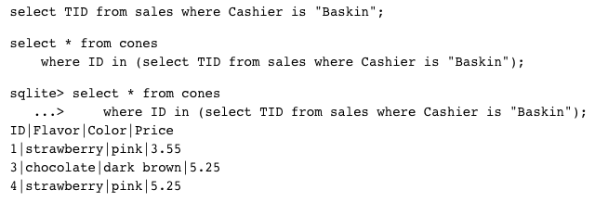
Queries within queries
Any place that a table is named within a select statement, a table could be computed
As a sub-query

Slide 22
SQL: CREATE and INSERT and UPDATE
(THIS IS NOT TESTED IN 88C!)

Slide 23
CREATE TABLE
SQL often used interactively
Result of select displayed to the user, but not stored
Can create a table in many ways
Often may just supply a list of columns without data.
Create table statement gives the result a name
Like a variable, but for a permanent object
CREATE TABLE [name] AS [select statement];

Slide 24
SQL: creating a named table
CREATE TABLE cones AS
select 1 as ID, "strawberry" as Flavor, "pink" as Color, 3.55 as Price union
select 2, "chocolate", "light brown", 4.75 union
select 3, "chocolate", "dark brown", 5.25 union
select 4, "strawberry", "pink",5.25 union
select 5, "bubblegum", "pink",4.75 union
select 6, "chocolate", "dark brown", 5.25;
Notice how column names are introduced and implicit later on.

Slide 25
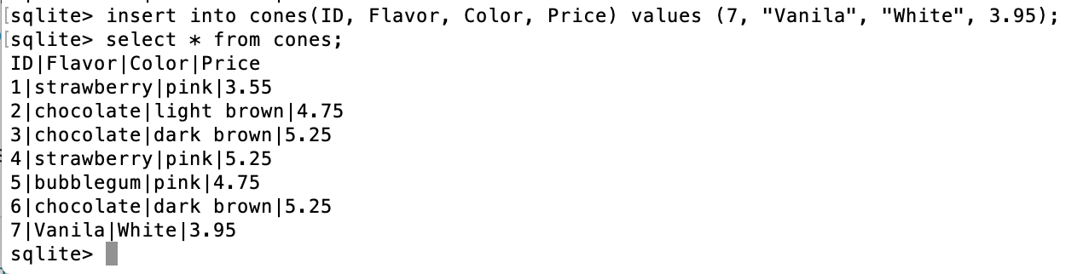
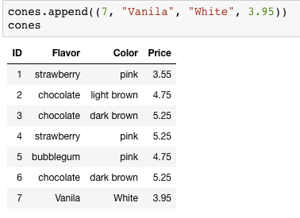
Inserting new records (rows)
A database table is typically a shared, durable repository shared by multiple applications
INSERT INTO table(column1, column2,...)
VALUES (value1, value2,...);

Slide 26
UPDATING new records (rows)
If you don’t specify a WHERE, you’ll update all rows!
UPDATE table SET column1 = value1, column2 = value2 [WHERE condition];

Slide 27
Summary (and https://code.cs61a.org SQL demo!)
SELECT <col spec> FROM <table spec> WHERE <cond spec>
GROUP BY <group spec> ORDER BY <order spec> ;
INSERT INTO table(column1, column2,...)
VALUES (value1, value2,...);
CREATE TABLE name ( <columns> ) ;
CREATE TABLE name AS <select statement> ;

